Slide 1
Computer Vision
Computer Vision Initiation

Slide 2
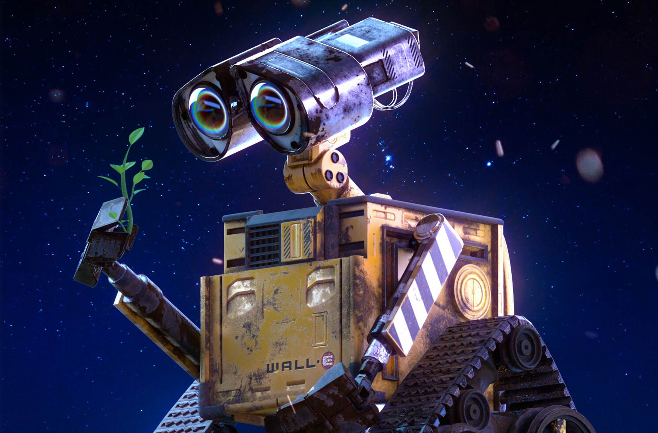
Plan
Context
Purpose
Problems
Potential
Tasks
Classification
Object detection
Segmentation
Image creation
Tools
OpenCV
Keras

Slide 3
Context
Overview and… Why does it matter ?

Slide 4

Purpose
Computer vision is a field of artificial intelligence that trains computers to interpret and understand the visual world. Using digital images from cameras and videos and deep learning models, machines can accurately identify and classify objects — and then react to what they “see.”
Object detection
Object tracking
Image segmentation / search
3D scene modeling

Slide 5
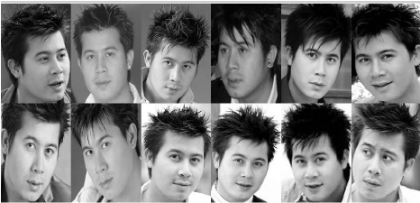
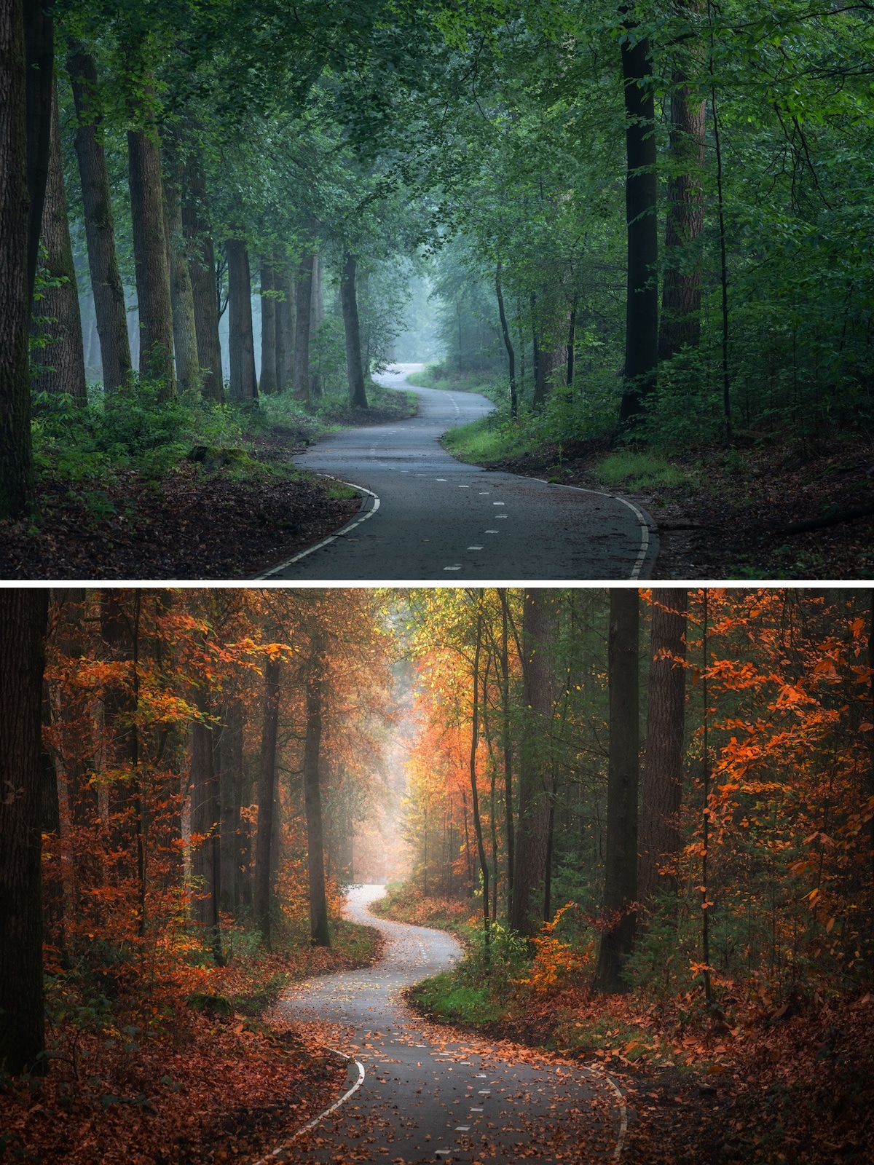
Problems
Object orientation
Lighting conditions
Obstruction
…
Too many possibilities !
Notes:
Computers work well for tightly constrained problems, not open unbounded problems like visual perception.

Slide 6
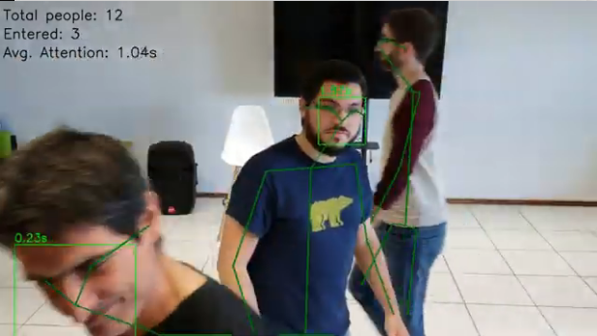
Potential
Behavioral tracking
Biomédical
Robotics
Airports
Security / Surveillance
Space exploration
Customer experience
...

Slide 7
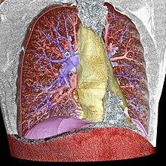
Potential
Healthcare
Biomédical
Robotics
Airports
Security / Surveillance
Space exploration
Customer experience
...

Slide 8

Potential
Autonomous vehicles
Biomédical
Robotics
Airports
Security / Surveillance
Space exploration
Customer experience
...

Slide 9

Tasks
Classification - detection - segmentation - creation
Notes:
Exemples: https://tryolabs.com/resources/introductory-guide-computer-vision/
Theory : https://ai.stackexchange.com/questions/21970/what-are-the-main-algorithms-used-in-computer-vision
https://heartbeat.fritz.ai/6-significant-computer-vision-problems-solved-by-ml-623eb50544c5

Slide 10
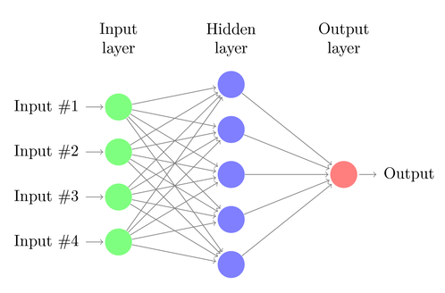
MLP
Feature detectors
Feature descriptors
250 | 249 | 249 | 248 | 242
246 | 244 | 243 | 228 | 230
244 | 242 | 240 | 230 | 231
241 | 240 | 240 | 229 | 230
... | ... | ... | ... | ...
A
(240, 230, ...)
B
(190, 210, ...)
C
(40, 150, ...)
D
(200, 180, ...)

Slide 11

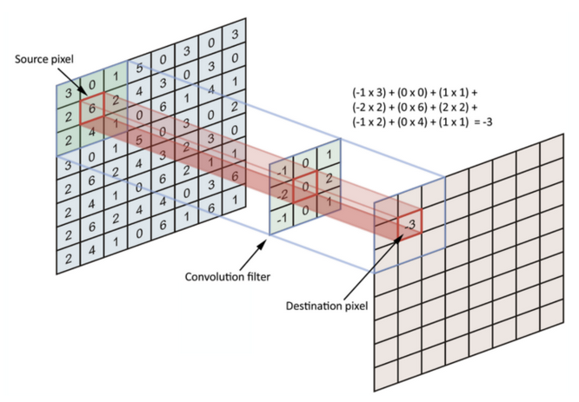
CNN
Notes:
https://towardsdatascience.com/simple-introduction-to-convolutional-neural-networks-cdf8d3077bac
https://towardsdatascience.com/convolutional-neural-networks-explained-9cc5188c4939

Slide 12

CNN

Slide 13
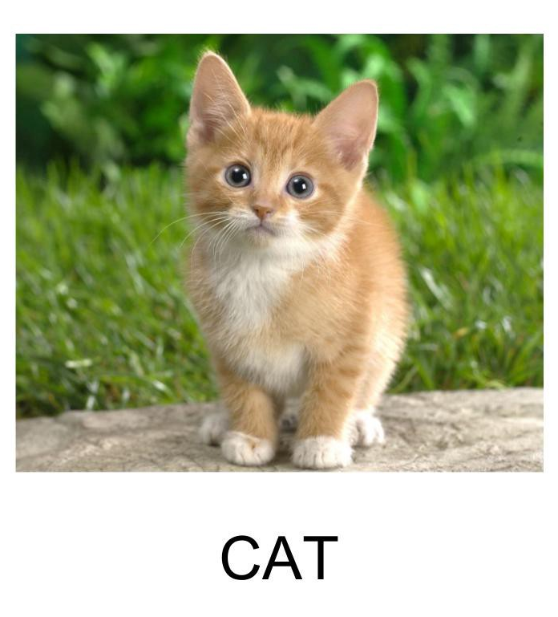
Classification
Particularity:
N possible outputs with N = number of classes.
Algorithms
Datasets
Models
Mark 1
SVM
CNN
ImageNet
CIFAR 100
ISIC
MURA
DermNet
LeNet5
VGG
GoogleNet / MobileNet
RestNet

Slide 14
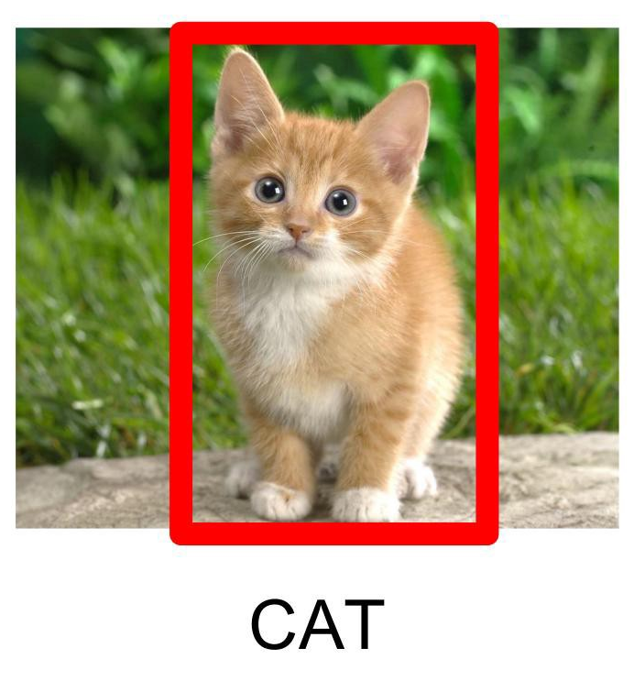
Object detection
Particularity:
Is an object present ?
Location:
x and y (top left of the object area, or center)
Area height and width
Algorithms
Datasets
Models
Sliding window
CNN
ImageNet
COCO
PASCAL
R-CNN
YOLO
SSD

Slide 15
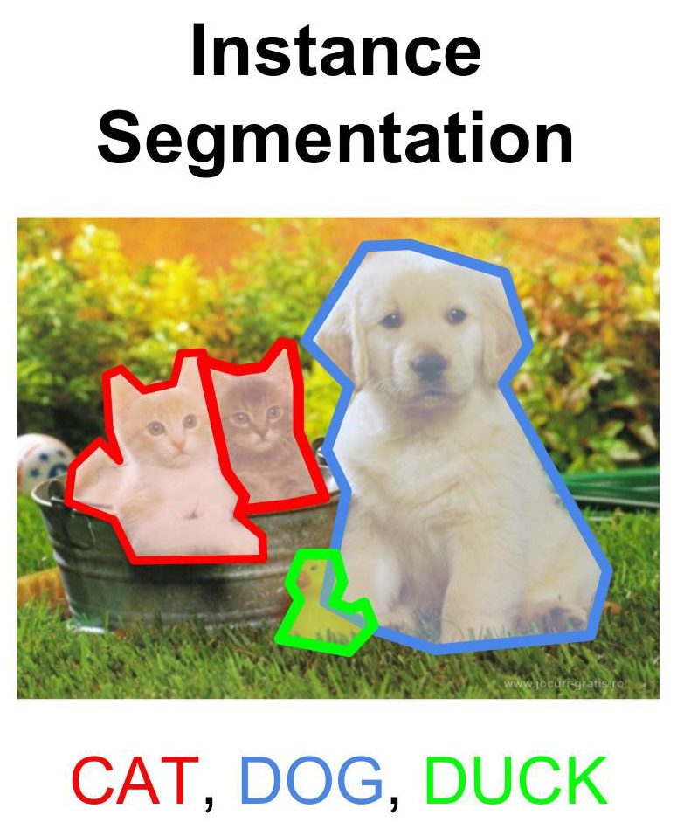
Image segmentation
Particularity:
Is an object present ?
Object boundaries
Give a value for each pixel
Algorithms
Datasets
Models
CNN
COCO
PASCAL
BraTS
Agriculture-Vision
SpaceNet
U-net
Mask R-CNN

Slide 16
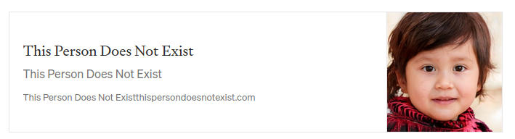
Image creation
Particularity:
Give a value for each pixel
Unlike any training image
Algorithms
Datasets
Models
CNN
Any...
GANs
VAEs

Slide 17
CV Tools
Image processing and ML

Slide 18
OpenCV
What it can do
Characteristics
Image processing
2D feature extraction
Predefined ML
GUI
Object detection
Video analysis and creation
3D reconstruction
Written in C++
Doc not great...
First release 2006
40+k users / 18M download
Supports Python, C++, Java, Matlab, CUDA
All platformes (mobile included)
Used by Google, Yahoo, Microsoft, Intel, IBM, Sony, Honda, Toyota
Notes:
https://data-flair.training/blogs/keras-vs-opencv/

Slide 19
Keras
What it can do
Characteristics
Built on top of tensorflow
Deep learning framework
Pre-trained model on ImageNet
Multi-GPU / distributed training
Written in python
Impressive documentation
First release 2015
400+k users
Supports Python, CUDA
All platformes (mobile included)
Used by Netflix, Uber, Instacart, CERN, NASA, NIH
#2 after scikit-learn for ML usage on Kaggle competition
Notes:
https://data-flair.training/blogs/keras-vs-opencv/

Slide 20
Exercices
Kaggle and your project

Slide 21

Quizz Kahoot !
Link: https://kahoot.it/
Pin: …

Slide 22
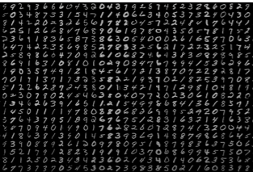
Compete: digit recognizer
Link: kaggle.com/c/digit-recognizer
Create your team !
Define your strategy
Submit your model

